Slide 1
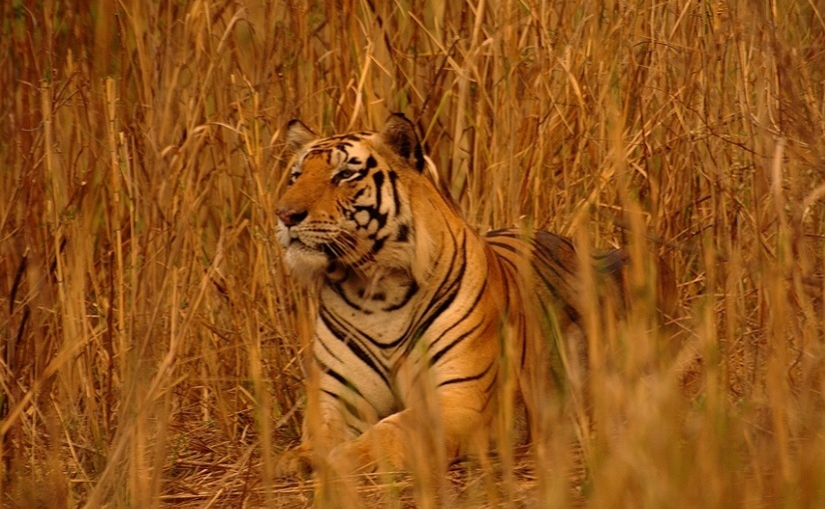
Adaption of XCS to Multi-Learner Predator/Prey Scenarios
Clemens Lode, Urban Richter, Hartmut Schmeck
Karlsruhe Institute of Technology (Germany)
Institute AIFB
July, GECCO 2010

Slide 2
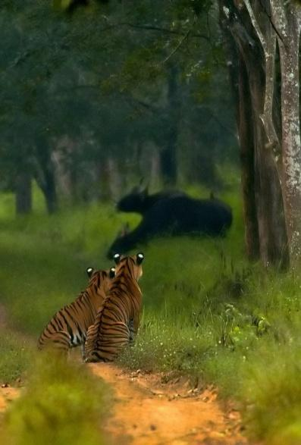
Outline
Learning Classifier Systems
XCS in Predator/Prey Scenarios
Adapting the Reward Function
http://www.flickr.com/photos/yathin

Slide 3
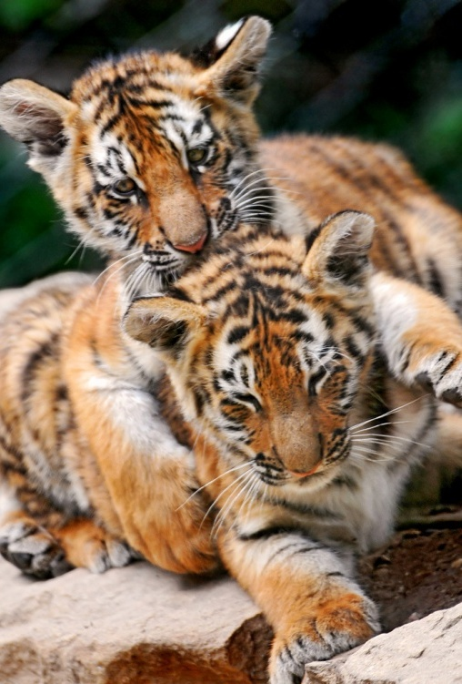
Learning Classifier Systems
1. Learning Classifier Systems:
Introduction and Terminology
Single-Step vs. Multi-Step Problems
Markov/Non Markov Environments
http://www.flickr.com/photos/tambako

Slide 4
Environment
Input: 0011
Population [P]
C A ρ ε F
#011 : 01 43 .01 99
11## : 00 32 .13 9
#0## : 11 14 .05 52
001# : 01 27 .24 3
#0#1 : 11 18 .02 92
1#01 : 10 24 .17 15
…
Action: 01
Reward
Prediction array
Action set [A]
Match set [M]
Action
selection
00 01 10 11
nil 42.5 nil 16.6
#011 : 01 43 .01 99
001# : 01 27 .24 3
#011 : 01 43 .01 99
#0## : 11 14 .05 52
001# : 01 27 .24 3
#0#1 : 11 18 .02 92
Max
Discount
+
Delay = 1
P
Previous
action set [A]₋₁
Genetic
operators
Covering
Update ρ ε F

Slide 5
Learning Classifier Systems
Standard (Multi-Step) Problem:
Maze6
Goal:
Find shortest path to the food starting from a random point
T: Tree
F: Food

Slide 6
Learning Classifier Systems
Standard (Multi-Step) Problem:
Maze6
Goal:
Find shortest path to the food starting from a random point
T: Tree
F: Food

Slide 7
Learning Classifier Systems
Problem:
Limited sensors, no global knowledge
Partially observable Markov decision process
Solution:
Iterations, back-propagation of reward
T: Tree
F: Food

Slide 8
Learning Classifier Systems
Problem:
Limited sensors, no global knowledge
Partially observable Markov decision process
Solution:
Iterations, back-propagation of reward
Aliasing positions:
Handle by using memory
T: Tree
F: Food

Slide 9
Learning Classifier Systems
What about more complex scenarios?

Slide 10
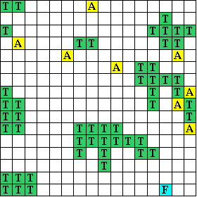
Learning Classifier Systems
What about more complex scenarios?
Many aliasing positions
Other agents present
Dynamic world
food and other agents move
Limited sensors
T: Trees
F: Food
A: Agent

Slide 11
Predator/Prey Scenarios
Terminology:
Obstacles, Prey, Predator
Goal: Get near the moving prey as often as possible
Global observation task
Continuous
Average Quality
T: Trees/Obstacles
F: Food/Prey
A: Agent/Predator

Slide 12
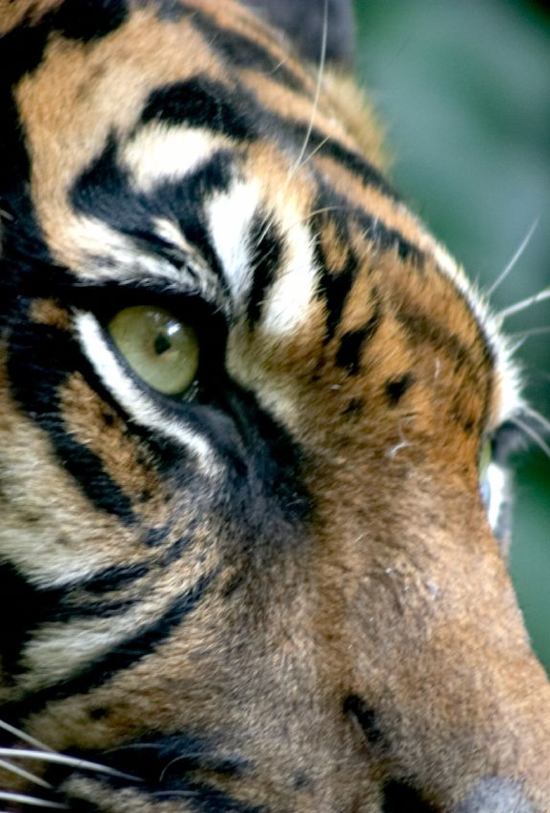
Using XCS to solve Predator/Prey Scenarios
Sensory abilities
Classification of the predator/prey scenario
Adaption of the reward function
http://www.flickr.com/photos/mortalcoil/

Slide 13
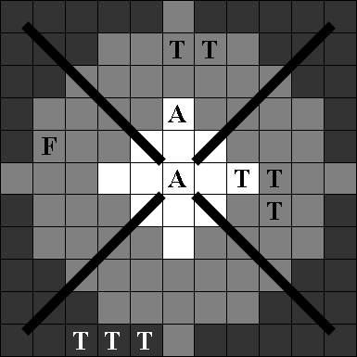
Sensors

Slide 14
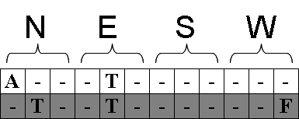
Sensors
One sensor array for each direction

Slide 15
Sensors
One sensor array for each direction
Sensors can sense either far or near

Slide 16
Sensors
One sensor array for each direction
Sensors can sense either far or near
Sensors can distinguish between Predators, Prey and Obstacles

Slide 17
Classification of Predator/Prey Scenarios
Access to local information only
open areas with some obstacles
internal state unknown to others
No standard MDP
Limited sensors (1, 3)
Aliasing positions (2)

Slide 18
Classification of Predator/Prey Scenarios
Access to local information only
open areas with some obstacles
internal state unknown to others
dynamic scenario
No standard MDP
Limited sensors (1, 3)
Aliasing positions (2)
No POMDP
Non-static scenario (4)

Slide 19
Classification of Predator/Prey Scenarios
Access to local information only
open areas with some obstacles
internal state unknown to others
dynamic scenario
predators share global observation task
runs continuously
No standard MDP
Limited sensors (1, 3)
Aliasing positions (2)
No POMDP
Non-static scenario (4)
XCS has to be adapted
No “final” reward (5), no iterations (6)

Slide 20
Reward Function
Standard implementation:
Reward:
Food is in a neighboring cell
Action:
Assign reward
Restart scenario
Switch between explore/exploit phase
Adapted implementation
Reward:
Food is in observation range (“XCS obs”)
Food is in sight range (“XCS sight”)
Action:
Assign reward
Continue scenario
Always use exploit phase

Slide 21
Classification of Predator/Prey Scenarios
Global knowledge cannot be reconstructed
Memory becomes invalid after each step
The predator/prey scenario is a Non-observable Markov Decision Processes

Slide 22
Classification of Predator/Prey Scenarios
Global knowledge cannot be reconstructed
Memory becomes invalid after each step
The predator/prey scenario is a Non-observable Markov Decision Processes
Despite being a NOMDP, can the XCS still learn?

Slide 23
Classification of Predator/Prey Scenarios
Global knowledge cannot be reconstructed
Memory becomes invalid after each step
The predator/prey scenario is a Non-observable Markov Decision Processes
Despite being a NOMDP, can the XCS still learn?
Possibly, the environment does not completely change each turn
Let’s look at some results

Slide 24
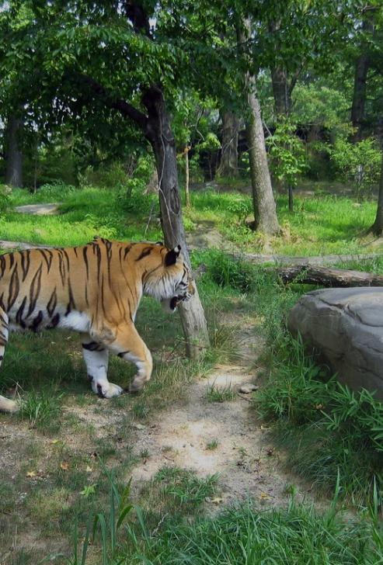
4. Testing Methodology
4. Testing Methodology:
Three Scenarios
“XCS obs”, “XCS sight”
“Obstacle-evading prey”, “Predator-evading prey”

Slide 25
ce

Slide 26
4. Testing Methodology
XCS Variants
Scenario Settings
Scenario Configurations
Pillar Scenario
Random Scenario
Difficult Scenario

Slide 27
4. Testing Methodology
XCS Variants
Scenario Settings
Scenario Configurations
Pillar Scenario
Random Scenario
Difficult Scenario

Slide 28
4. Testing Methodology
XCS Variants
XCS (obs)
XCS (sight)
eventXCS
Scenario Settings
Scenario Configurations
Pillar Scenario
Random Scenario
Difficult Scenario
Standard implementation of XCS
For reward:
prey: only use observation range
Ignore other predators

Slide 29
4. Testing Methodology
XCS Variants
XCS (obs)
XCS (sight)
eventXCS
Scenario Settings
Scenario Configurations
Pillar Scenario
Random Scenario
Difficult Scenario
Standard implementation of XCS
For reward:
prey: use sight range
Ignore other predators

Slide 30
4. Testing Methodology
XCS Variants
XCS (obs)
XCS (sight)
eventXCS
Scenario Settings
Scenario Configurations
Pillar Scenario
Random Scenario
Difficult Scenario
XCS standard implementation with
event handling
reward distribution
For reward:
prey: use sight range
Ignore other predators

Slide 31
4. Testing Methodology
XCS Variants
Scenario Settings
Scenario Configurations
Pillar Scenario
Random Scenario
Difficult Scenario
Torus
16x16 fields
9 Agents
8 Predators
1 Prey
Number of Obstacles
Block sight and movement
→ Scenario Configuration

Slide 32
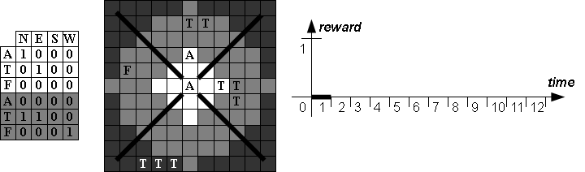
Base Reward and Reward Events

Slide 33
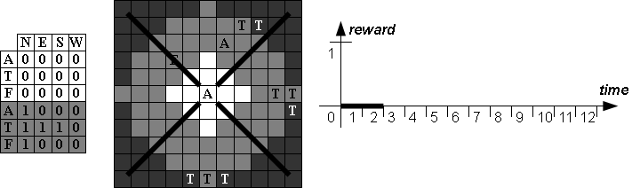
Base Reward and Reward Events

Slide 34
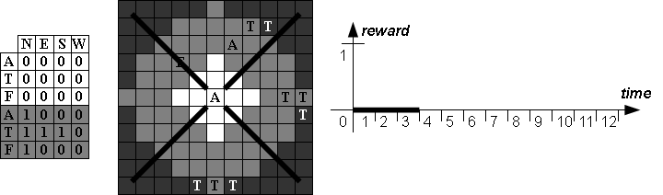
Base Reward and Reward Events

Slide 35
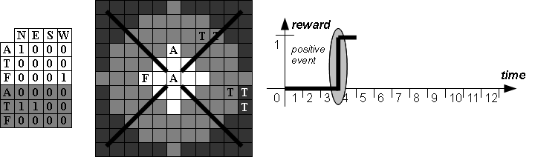
Base Reward and Reward Events

Slide 36
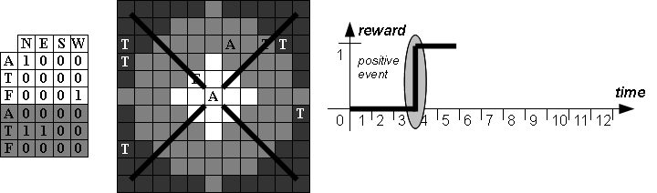
Base Reward and Reward Events

Slide 37

Base Reward and Reward Events

Slide 38
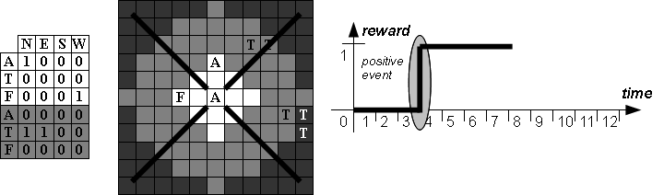
Base Reward and Reward Events

Slide 39
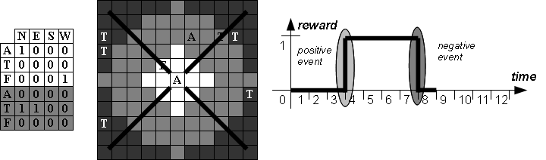
Base Reward and Reward Events

Slide 40
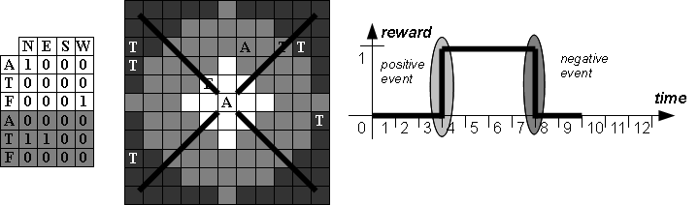
Base Reward and Reward Events

Slide 41
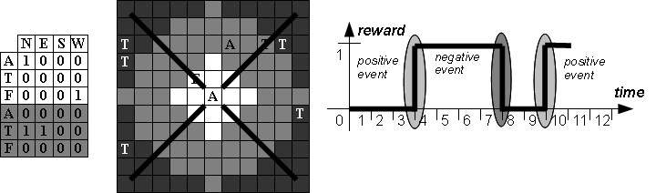
Base Reward and Reward Events

Slide 42
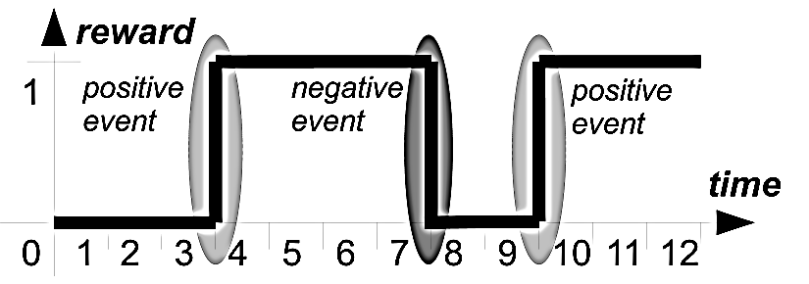
Reward Distribution
Analyze succession of positive and negative events

Slide 43
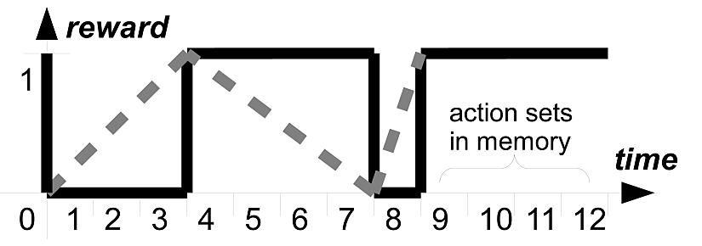
Reward Distribution
Analyze succession of positive and negative events
Distribute the reward as soon as possible (i.e. at each event)
Idea:
Action sets closer to an event probably contributed more

Slide 44
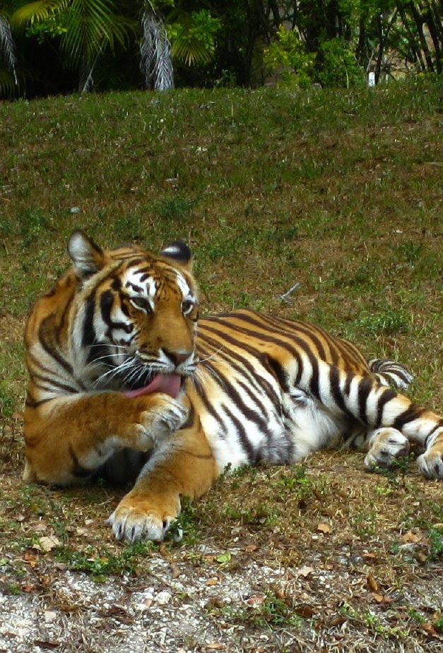
5. Experimental Results
4. Testing Methodology:
XCS Variants
Scenario Settings
Scenario Configurations
5. Experimental Results:
XCS Parameters
Comparison of XCS Variants

Slide 45
Backup Slides
Neutral Events
Max Stack Size Experiments
Learning Rate Beta Experiments

Slide 46
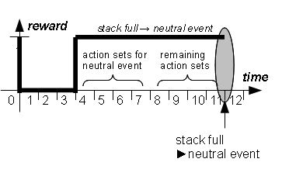
Neutral Events
Neutral Event
No positive or negative event for a number of steps
Half of the action sets is discarded and receives reward
Idea:
Good actions are rewarded earlier
Preventing of dead ends
46

Slide 47
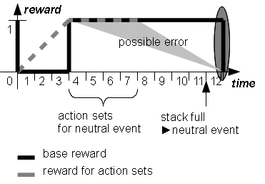
Neutral Events
Neutral Event
No positive or negative event for a number of steps
Half of the action sets is discarded and receives reward
Idea:
Good actions are rewarded earlier
Preventing of dead ends
Problem:
Error possibility high if directly followed by an event.
47

Slide 48
Neutral Events
Tests have shown that a stack size of 8 is generally good for all three scenarios
“Pillar Scenario”
“Random Scenario”
“Difficult Scenario”

Slide 49
Learning Rate β
Pillar Scenario
Obstacle-evading prey
Low learning rate (0.05) good, eventXCS very stable

Slide 50
5. Experimental Results
Random Scenario, Obstacle evading prey
Pillar Scenario Predator-evading prey
Random Scenario, Predator evading

Slide 51
5. Experimental Results
Difficult Scenario
Blind prey
High learning rates show an advantage because of long distance to the prey

Slide 52
5. Experimental Results
Comparison of XCS Variants
Pillar Scenario
Obstacle-evading prey
Predator-evading prey
Random Scenario
Difficult Scenario

Slide 53
5. Experimental Results
Comparison of XCS Variants
Pillar Scenario
Obstacle-evading prey
Predator-evading prey
Random Scenario
Difficult Scenario

Slide 54
5. Experimental Results
Comparison of XCS Variants
Pillar Scenario
Random Scenario
Obstacle-evading prey
Predator-evading prey
Difficult Scenario

Slide 55
5. Experimental Results
Comparison of XCS Variants
Pillar Scenario
Random Scenario
Obstacle-evading prey
Predator-evading prey
Difficult Scenario

Slide 56
5. Experimental Results
Comparison of XCS Variants
Pillar Scenario
Random Scenario
Difficult Scenario
Blinded prey

Slide 57
Recap (1)
1. Learning Classifier Systems:
Introduction and Terminology
Single-Step vs. Multi-Step Problems
Markov/Non Markov Environments
2. Predator/Prey Scenarios:
Introduction
Classification
http://www.flickr.com/photos/tambako

Slide 58

Recap (1)
1. Learning Classifier Systems:
Introduction and Terminology
Single-Step vs. Multi-Step Problems
Markov/Non Markov Environments
2. Predator/Prey Scenarios:
Introduction
Classification
http://www.flickr.com/photos/yathin

Slide 59
Recap (2)
3. Sensors and Reward:
Sensory Abilities of an Agent
Reward Events
Reward Distribution
http://www.flickr.com/photos/mortalcoil/

Slide 60
Recap (3)
4. Testing Methodology:
XCS Variants
Scenario Settings
Scenario Configurations
5. Experimental Results:
XCS Parameters
Comparison between standard XCS and event-based XCS
http://www.flickr.com/photos/james_crowley

Slide 61
Recap (3)
4. Testing Methodology:
XCS Variants
Scenario Settings
Scenario Configurations
5. Experimental Results:
XCS Parameters
Comparison between standard XCS and event-based XCS
http://www.flickr.com/photos/readontheroad

Slide 62
Adaption of XCS to Multi-Learner Predator/Prey Scenarios
Questions?

Slide 63
1. Learning Classifier Systems
Terminology:
Classifier: condition/action pair
Condition: Usually an array of bits including wild cards
Action: The “result” (e.g. movement command)
Match set: Set of classifiers whose condition match the sensory input
Action set: Sub set of the match set whose classifiers share a certain action value
Condition | Action
100110 | North
1001#0 | North
0##### | North
1001## | East
1011## | East
0011## | South
#####1 | West
##1### | West
##111# | West

Slide 64
1. Learning Classifier Systems
Terminology:
Classifier: condition/action pair
Condition: Usually an array of bits including wild cards
Action: The “result” (e.g. movement command)
Match set: Set of classifiers whose condition match the sensory input
Action set: Sub set of the match set whose classifiers share a certain action value
Condition | Action
100110 | North
1001#0 | North
0##### | North
1001## | East
1011## | East
0011## | South
#####1 | West
##1### | West
##111# | West

Slide 65
1. Learning Classifier Systems
Terminology:
Classifier: condition/action pair
Condition: Usually an array of bits including wild cards
Action: The “result” (e.g. movement command)
Match set: Set of classifiers whose condition match the sensory input
Action set: Sub set of the match set whose classifiers share a certain action value
Condition | Action
100110 | North
1001#0 | North
0##### | North
1001## | East
1011## | East
0011## | South
#####1 | West
##1### | West
##111# | West
100100
100101
100110
100111

Slide 66
1. Learning Classifier Systems
Terminology:
Classifier: condition/action pair
Condition: Usually an array of bits including wild cards
Action: The “result” (e.g. movement command)
Match set: Set of classifiers whose condition match the sensory input
Action set: Sub set of the match set whose classifiers share a certain action value
Condition | Action
100110 | North
1001#0 | North
0##### | North
1001## | East
1011## | East
0011## | South
#####1 | West
##1### | West
##111# | West

Slide 67
1. Learning Classifier Systems
Terminology:
Classifier: condition/action pair
Condition: Usually an array of bits including wild cards
Action: The “result” (e.g. movement command)
Match set: Set of classifiers whose condition match the sensory input
Action set: Sub set of the match set whose classifiers share a certain action value
Condition | Action
100110 | North
1001#0 | North
0##### | North
1001## | East
1011## | East
0011## | South
#####1 | West
##1### | West
##111# | West
001110

Slide 68
1. Learning Classifier Systems
Terminology:
Classifier: condition/action pair
Condition: Usually an array of bits including wild cards
Action: The “result” (e.g. movement command)
Match set: Set of classifiers whose condition match the sensory input
Action set: Sub set of the match set whose classifiers share a certain action value
Condition | Action
100110 | North
1001#0 | North
0##### | North
1001## | East
1011## | East
0011## | South
#####1 | West
##1### | West
##111# | West
001110, West

Slide 69
1. Learning Classifier Systems
Generation of classifiers:
Unknown input
Crossover and Mutation
Selection of classifiers
Random
Best Selection
Roulette Wheel Selection
Tournament Selection
Condition | Action
100110 | North
1001#0 | North
0##### | North
1001## | East
1011## | East
0011## | South
#####1 | West
##1### | West
##111# | West
?
100000

Slide 70
1. Learning Classifier Systems
Condition | Action
100110 | North
1001#0 | North
0##### | North
1001## | East
1011## | East
0011## | South
#####1 | West
##1### | West
##111# | West
1000#0 | North
10000# | East
1##000 | South
##0000 | West
Generation of classifiers:
Unknown input
Crossover and Mutation
Selection of classifiers
Random
Best Selection
Roulette Wheel Selection
Tournament Selection
100000

Slide 71
1. Learning Classifier Systems
Generation of classifiers:
Unknown input
Crossover and Mutation
Selection of classifiers
Random
Best Selection
Roulette Wheel Selection
Tournament Selection
Condition | Action | Fitness
100110 | North | 0.7
1001#0 | North | 0.2
0##### | North | 0.4
1001## | East | 0.5
1011## | East | 0.5
0011## | South | 0.1
#####1 | West | 0.3
##1### | West | 0.2
##111# | West | 0.3
Fitness =
Accuracy of Prediction * Value of Prediction

Slide 72
1. Learning Classifier Systems
Generation of classifiers:
Unknown input
Crossover and Mutation
Selection of classifiers
Random
Best Selection
Roulette Wheel Selection
Tournament Selection
Condition | Action | Fitness
100110 | North | 0.7
1001#0 | North | 0.2
0##### | North | 0.4
1001## | East | 0.5
1011## | East | 0.5
0011## | South | 0.1
#####1 | West | 0.3
##1### | West | 0.2
##111# | West | 0.3

Slide 73
1. Learning Classifier Systems
Generation of classifiers:
Unknown input
Crossover and Mutation
Selection of classifiers
Random
Best Selection
Roulette Wheel Selection
Tournament Selection
Condition | Action | Fitness
100110 | North | 0.7
1001#0 | North | 0.2
0##### | North | 0.4
1001## | East | 0.5
1011## | East | 0.5
0011## | South | 0.1
#####1 | West | 0.3
##1### | West | 0.2
##111# | West | 0.3
001110

Slide 74
1. Learning Classifier Systems
Generation of classifiers:
Unknown input
Crossover and Mutation
Selection of classifiers
Random
Best Selection
Roulette Wheel Selection
Tournament Selection
Condition | Action | Fitness
100110 | North | 0.7
1001#0 | North | 0.2
0##### | North | 0.4
1001## | East | 0.5
1011## | East | 0.5
0011## | South | 0.1
#####1 | West | 0.3
##1### | West | 0.2
##111# | West | 0.3
33%
33%
33%
001110

Slide 75
1. Learning Classifier Systems
Generation of classifiers:
Unknown input
Crossover and Mutation
Selection of classifiers
Random
Best Selection
Roulette Wheel Selection
Tournament Selection
Condition | Action | Fitness
100110 | North | 0.7
1001#0 | North | 0.2
0##### | North | 0.4
1001## | East | 0.5
1011## | East | 0.5
0011## | South | 0.1
#####1 | West | 0.3
##1### | West | 0.2
##111# | West | 0.3
100%
001110

Slide 76
1. Learning Classifier Systems
Generation of classifiers:
Unknown input
Crossover and Mutation
Selection of classifiers
Random
Best Selection
Roulette Wheel Selection
Tournament Selection
Condition | Action | Fitness
100110 | North | 0.7
1001#0 | North | 0.2
0##### | North | 0.4
1001## | East | 0.5
1011## | East | 0.5
0011## | South | 0.1
#####1 | West | 0.3
##1### | West | 0.2
##111# | West | 0.3
40%
10%
50%
001110

Slide 77
1. Learning Classifier Systems
Generation of classifiers:
Unknown input
Crossover and Mutation
Selection of classifiers
Random
Best Selection
Roulette Wheel Selection
Tournament Selection
Condition | Action | Fitness
100110 | North | 0.7
1001#0 | North | 0.2
0##### | North | 0.4
1001## | East | 0.5
1011## | East | 0.5
0011## | South | 0.1
#####1 | West | 0.3
##1### | West | 0.2
##111# | West | 0.3
84%
3%
13%
001110

